Slide 1


DEPARTMENT OF ELECTRONICS AND COMMUNICATION ENGINEERING
Eye Pattern Estimation Method for Efficient Signal Integrity Analysis in PCB Design
GUIDED BY,
Dr.K.SIVANANDAM M.E.,Ph.D.
Associate Professor/ECE
PRESENTED BY:
ADHITHYAN.G(927622BEC004)
ANGURAJ KARTHICK.V(927622BEC010)
GAJENDRAN.P(927622BEC050)
GOPINATH.K(927622BEC059)
YEAR/SEMESTER-III/V
DATE:17.11.2024

Slide 2
ABSTRACT
This paper presents an efficient eye pattern estimation method to enhance signal integrity analysis in high-speed PCB design, reducing computational overhead while maintaining accuracy.
The proposed method aims to enable real-time analysis, speeding up design cycles, lowering costs, and ensuring reliable data transmission in modern electronics.

Slide 3
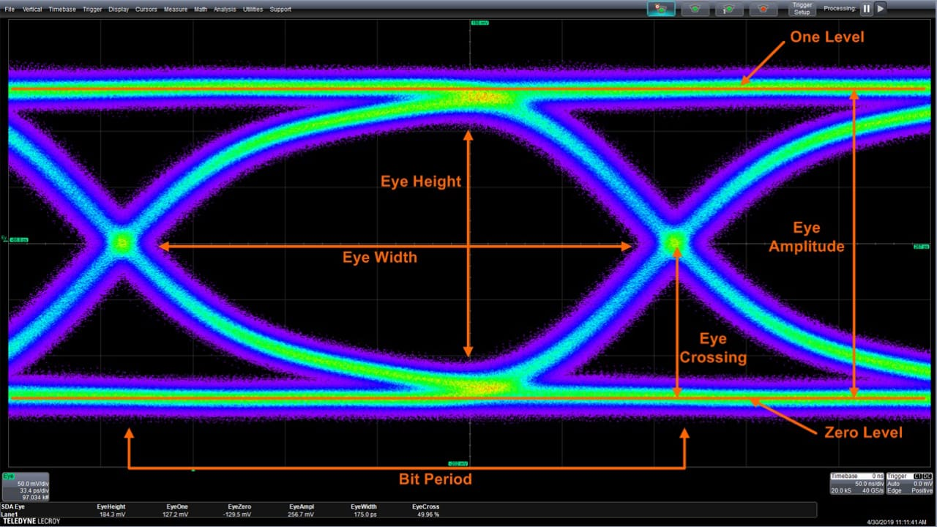
Eye Opening: The open space in the center of the eye diagram. A wider and clearer eye opening indicates better signal integrity and less distortion. If the eye is closing, it suggests issues like noise, jitter, or inter-symbol interference.
Eye Height: This is the vertical opening of the eye, representing the voltage margin for distinguishing between logic high (1) and logic low (0). A smaller eye height indicates higher levels of noise or signal attenuation.

Slide 4
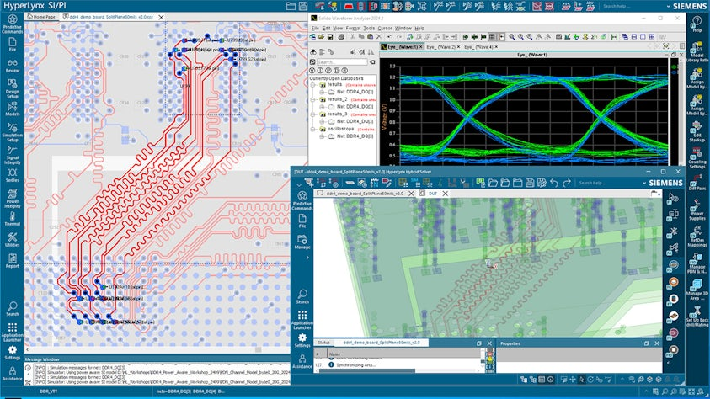
Eye Width: The horizontal opening, which represents the timing margin. If the eye width is too narrow, it indicates timing jitter or distortion.
Signal Distortion: Eye pattern analysis can highlight issues like ringing, overshoot, or undershoot that may distort the signal.

Slide 5
WORK PLAN
Define the Scope
Determine Parameters: Define key parameters to analyze, such as frequency range, voltage levels, and data rates.
Gather Required Tools and Data
Simulation Software: Use tools like SPICE, ANSYS, or HyperLynx for signal integrity simulations.
PCB Design Files: Ensure access to Gerber files and schematics of the circuit for accurate modeling.
Perform Pre-Layout Simulation
Signal Waveform Analysis: Simulate input and output waveforms to evaluate initial performance.
Identify Key Issues: Look for potential problems such as reflections, crosstalk, and voltage drops.
Post-Layout Simulation
Run Signal Integrity Analysis: Simulate with the extracted model to evaluate signal behavior under realistic conditions.
Analyze Eye Patterns: Generate eye diagrams to assess signal quality (jitter, noise margin).
Documentation and Reporting
Compile Results: Document findings, including simulations, measurements, and any design changes made.
Create Reports: Prepare a comprehensive report summarizing the analysis, conclusions, and recommendations for future designs.

Slide 6
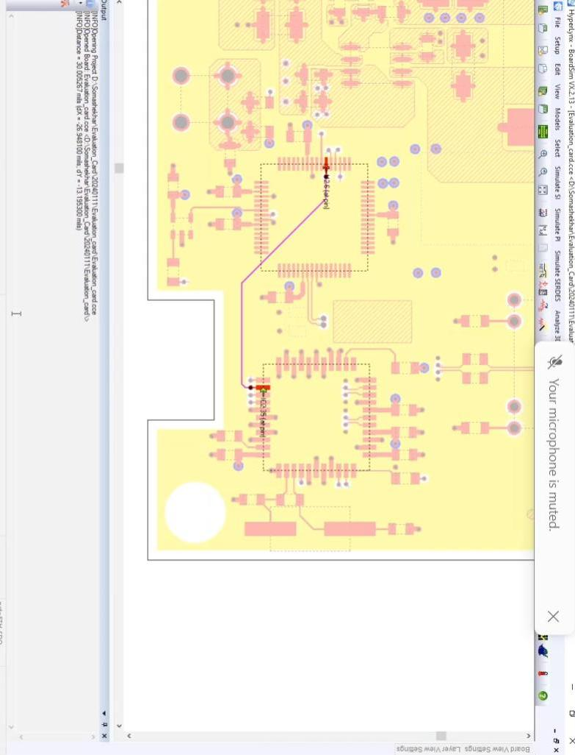
RESULT

Slide 7
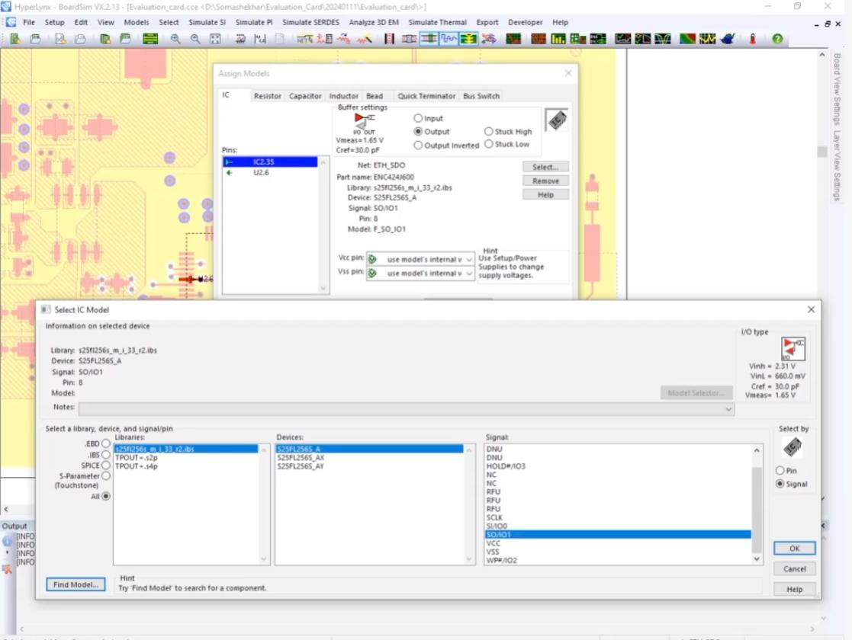

Slide 8
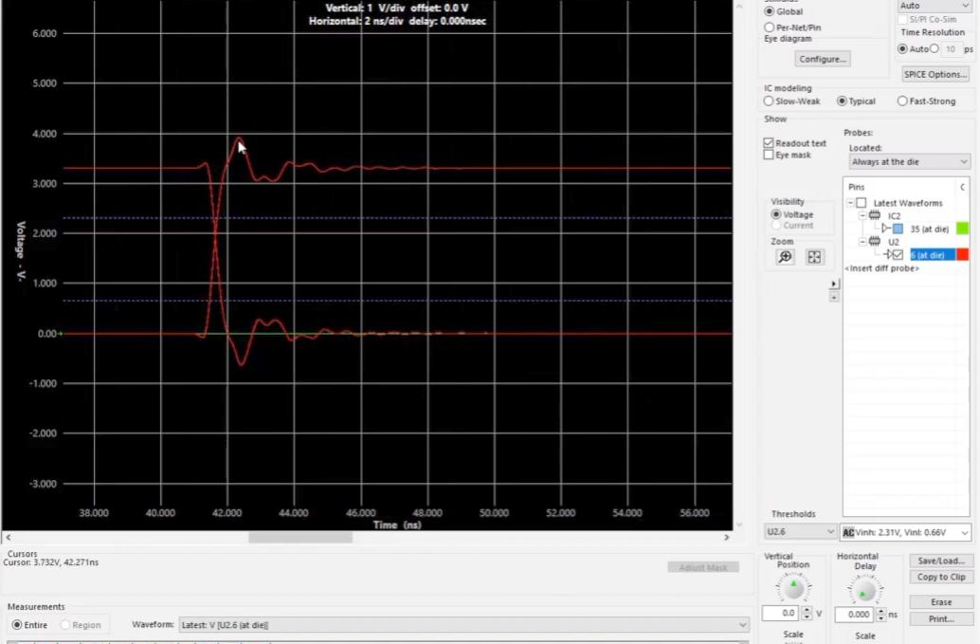
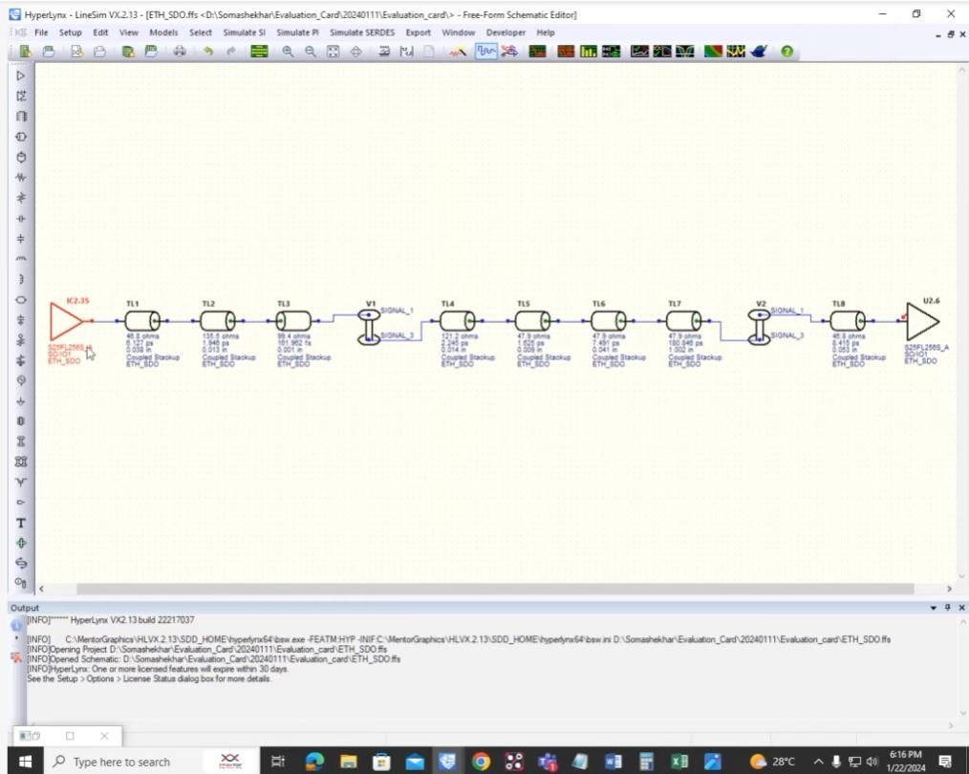
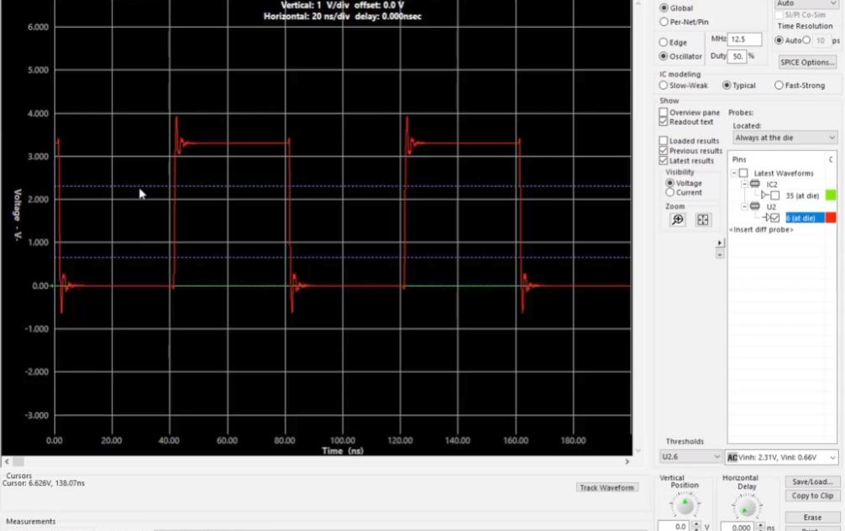

Slide 9
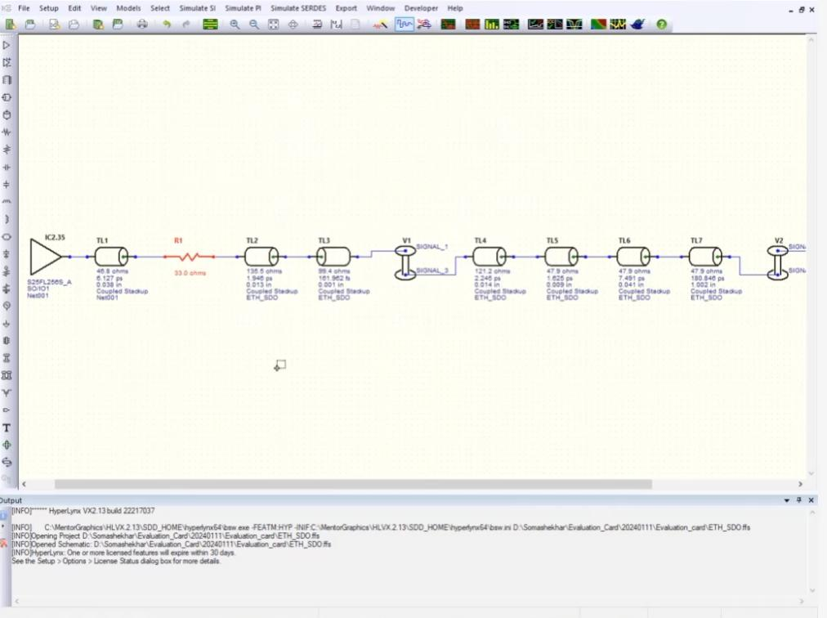
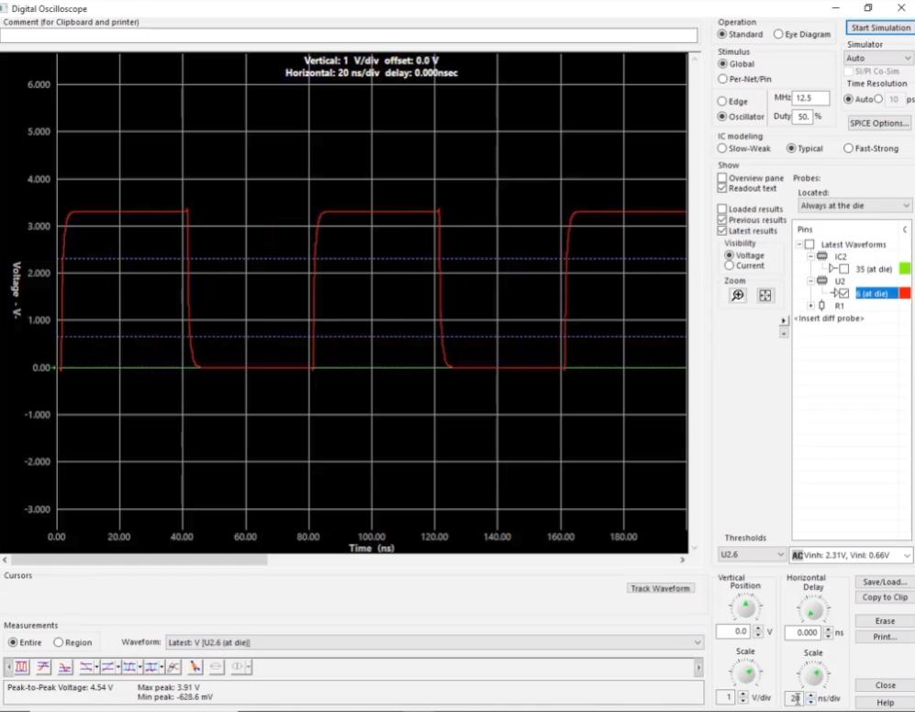

Slide 10


